Slide 1
Introduction to Machine Learning
Shahbaz Hassan
Lecturer

Slide 2
Decision Tree

Slide 3
Decision Tree
Decision Tree algorithm belongs to the family of supervised learning algorithms.
Unlike other supervised learning algorithms, the decision tree algorithm can be used for solving regression and classification problems too.
The goal of using a Decision Tree is to create a training model that can use to predict the class or value of the target variable by learning simple decision rules inferred from prior data(training data)

Slide 4
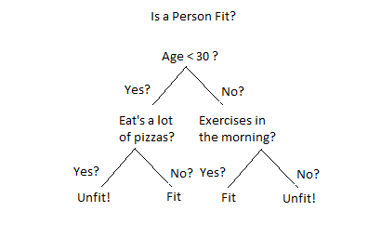
Decision Tree
The tree can be explained by two entities, namely decision nodes and leaves.
The leaves are the decisions or the final outcomes. And the decision nodes are where the data is split.

Slide 5
Decision Tree
A decision tree is a flowchart-like structure in which each internal node represents a test on a feature (e.g. whether a coin flip comes up heads or tails).
Each leaf node represents a class label (decision taken after computing all features) and branches represent conjunctions of features that lead to those class labels.
The paths from root to leaf represent classification rules

Slide 6
Types of Decision Tree.

Slide 7
Decision Tree Types
Types of decision trees are based on the type of target variable we have. It can be of two types:
Categorical Variable Decision Tree
Decision Tree which has a categorical target variable.
Continuous Variable Decision Tree
Decision Tree has a continuous target variable.

Slide 8
Important Terminology

Slide 9
Terminology
Root Node: It represents the entire population or sample and this further gets divided into two or more homogeneous sets.
Splitting: It is a process of dividing a node into two or more sub-nodes.
Decision Node: When a sub-node splits into further sub-nodes, then it is called the decision node.
Leaf / Terminal Node: Nodes do not split is called Leaf or Terminal node.

Slide 10
Terminology
Pruning: When we remove sub-nodes of a decision node, this process is called pruning. You can say the opposite process of splitting.
Branch / Sub-Tree: A subsection of the entire tree is called branch or sub-tree.
Parent and Child Node: A node, which is divided into sub-nodes is called a parent node of sub-nodes whereas sub-nodes are the child of a parent node.

Slide 11
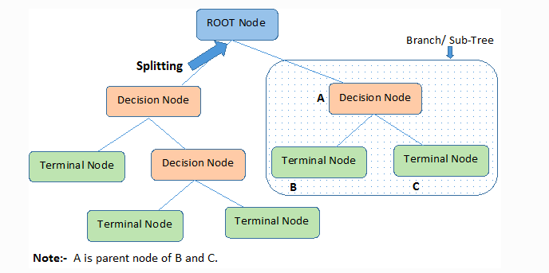
Terminology

Slide 12
Working

Slide 13
Working
There are many algorithms out there which construct Decision Trees, but one of the best is called as ID3 Algorithm.
Before discussing the ID3 algorithm, we’ll go through few definitions.
Entropy, Information Gain.

Slide 14

Working
Entropy
Entropy, also called as Shannon Entropy is denoted by H(S) for a finite set S, is the measure of the amount of uncertainty or randomness in data.
Consider a coin which has heads on both the sides, the entropy of such an event can be predicted perfectly since we know beforehand that it’ll always be heads. In other words, this event has no randomness hence it’s entropy is zero
In particular, lower values imply less uncertainty while higher values imply high uncertainty.

Slide 15

Working
Information Gain
It measures the relative change in entropy with respect to the independent variables.
Where IG(S, A) is the information gain by applying feature A. H(S) is the Entropy of the entire set, while the second term calculates the Entropy after applying the feature A, where P(x) is the probability of event x.

Slide 16
Working (Example)
Consider a piece of data collected over the course of 14 days where the features are Outlook, Temperature, Humidity, Wind and the outcome variable is whether Golf was played on the day.
Now, our job is to build a predictive model which takes in above 4 parameters and predicts whether Golf will be played on the day. We’ll build a decision tree to do that using ID3 algorithm.

Slide 17
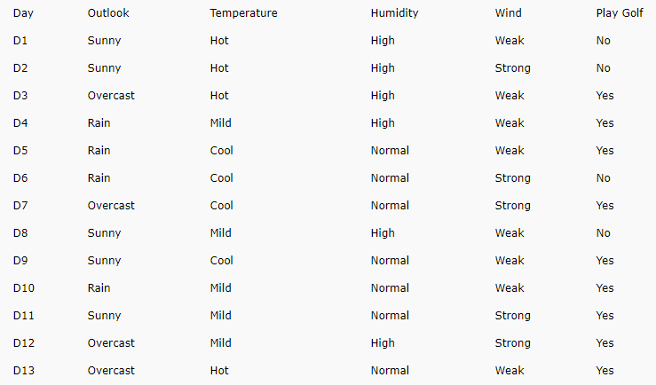
Working (Example)

Slide 18
Steps (ID3)
Create root node for the tree
If all examples are positive, return leaf node ‘positive’
Else if all examples are negative, return leaf node ‘negative’
Calculate the entropy of current state H(S)
For each attribute, calculate the entropy with respect to the attribute ‘x’ denoted by H(S, x)

Slide 19
Steps (ID3)
Select the attribute which has maximum value of IG(S, x)
Remove the attribute that offers highest IG from the set of attributes
Repeat until we run out of all attributes, or the decision tree has all leaf nodes.

Slide 20
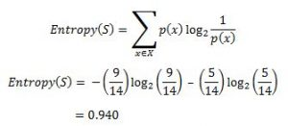
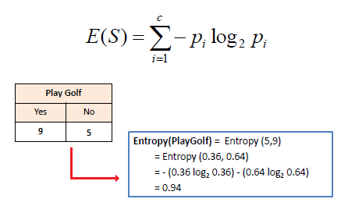
Example
Step 1: The initial step is to calculate H(S), the Entropy of the current state (Play Golf). In the above example, we can see in total there are 5 No’s and 9 Yes’s
Yes | No | Total
9 | 5 | 14
Notes:
Remember that the Entropy is 0 if all members belong to the same class, and 1 when half of them belong to one class and other half belong to other class that is perfect randomness. Here it’s 0.94 which means the distribution is fairly random.

Slide 21


Example
Step 2: Now the next step is to choose the attribute that gives us highest possible Information Gain which we’ll choose as the root node
Let’s start with ‘Wind’
where ‘x’ are the possible values for an attribute. Here, attribute ‘Wind’ takes two possible values in the sample data, hence x = {Weak, Strong}

Slide 22
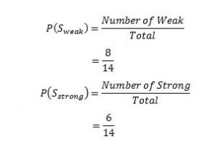
Example
Amongst all the 14 examples we have 8 places where the wind is weak and 6 where the wind is Strong.
Wind = Weak | Wind = Strong | Total
8 | 6 | 14

Slide 23


Example
Now out of the 8 Weak examples, 6 of them were ‘Yes’ for Play Golf and 2 of them were ‘No’ for ‘Play Golf’. So, we have
Similarly, out of 6 Strong examples, we have 3 examples where the outcome was ‘Yes’ for Play Golf and 3 where we had ‘No’ for Play Golf.

Slide 24
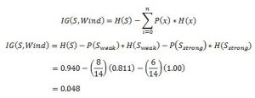
Example
Now we have all the pieces required to calculate the Information Gain.
Which tells us the Information Gain by considering ‘Wind’ as the feature and give us information gain of 0.048. Now we must similarly calculate the Information Gain for all the features

Slide 25
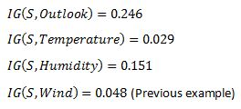
Example
Now,
We can clearly see that IG(S, Outlook) has the highest information gain of 0.246, hence we chose Outlook attribute as the root node.

Slide 26
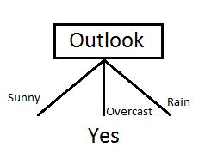
Example
At this point, the decision tree looks like.
We had three possible values of Outlook: Sunny, Overcast, Rain. Where the Overcast node already ended up having leaf node ‘Yes’.
So we’re left with two sub trees to compute: Sunny and Rain.

Slide 27

Example
Next Step would be computing H(S sunny)
Table where the value of Outlook is Sunny looks like.
Temperature | Humidity | Wind | Play Golf
Hot | High | Weak | No
Hot | High | Strong | No
Mild | High | Weak | No
Cool | Normal | Weak | Yes
Mild | Normal | Strong | Yes

Slide 28

Example
In the similar fashion, we compute the following values
As we can see the highest Information Gain is given by Humidity

Slide 29
Example
Humidity
High
Normal
YES
NO

Slide 30
Example
Proceeding in the same way with Srain
Rain | Mild | High | Weak | Yes
Rain | Cool | Normal | Weak | Yes
Rain | Cool | Normal | Strong | No
Rain | Mild | Normal | Weak | Yes
IG (Srain, Humidity) =
IG (Srain, Wind)=
IG (Srain, Temperature)=

Slide 31
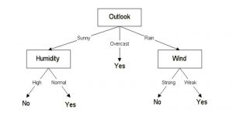
Example
will give us Wind as the one with highest information gain. The final Decision Tree looks something like this.

